Slide 1
AWS Gen AI

Slide 2
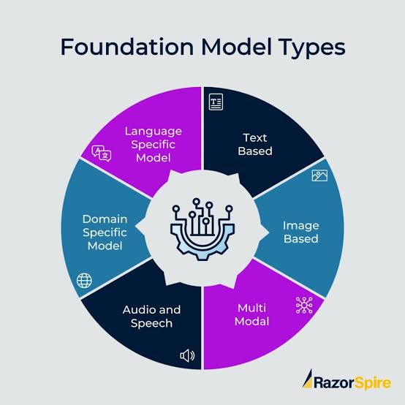
The Foundation Model Landscape – Key Players & Categories

Slide 3
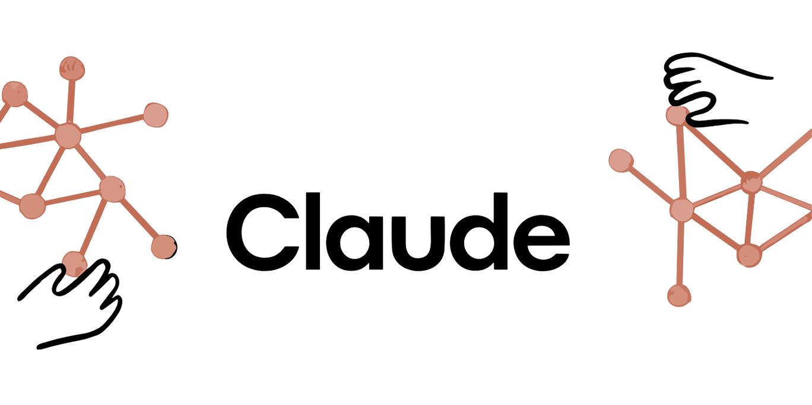
Claude (Anthropic) – Strengths & Ideal Use Cases

Slide 4
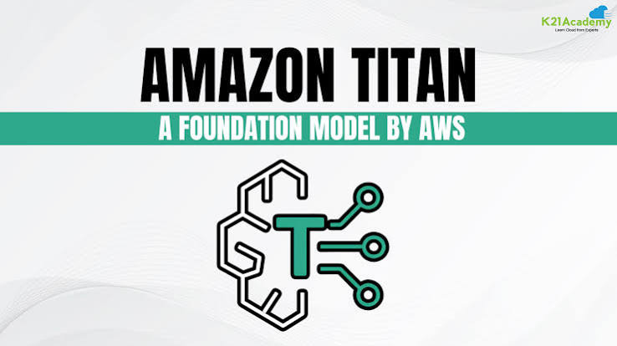
Amazon Titan – Native AWS Integration & Cost Efficiency

Slide 5
Thanks For Watching

